Slide 1
The Healthiest.
Esaa Yamini, Juan Sebastian galindo , Avantika singh, Darren lucca, tommy ringo

Slide 2
Motivation/Questions
Are Healthy Restaurants Healthy?
What Gender/Age do Healthy Restaurants Cater to?
Which Restaurant is Healthiest?
5 Austin, TX “healthy” restaurant chains were chosen.
FDA Guidelines and Nutritionix Restaurant data sources were used.
Each restaurant’s top 7 menu items compared against the others.
Menu items scored based on FDA recommended amounts of 14 nutrients:
Restaurants scored based on cumulative score of their top 7 menu items. A perfect restaurant score is 98. (7-menu items x 14-possible nutrient points)
SATURATED FAT – TRANS FAT – TOTAL FAT – SUGARS – CARBOHYDRATES – PROTEIN – CHOLESTEROL – VITAMIN C – VITAMIN A – SODIUM – IRON – CALCIUM – FIBER – CALORIES
Notes:
We wanted to know, Are healthy restaurants healthy?, What gender/age groups do healthy restaurants cater to (if any)?, and Which restaurant is healthiest?
We’ve selected 5 “healthy” restaurant chains in the Austin area to compare their menu nutrition against FDA guidelines of recommended values.
All restaurants fall within the “healthy restaurant” category when conducting a search.
We used nutrition guidelines from the FDA database and pulled restaurant nutrition information from a restaurant nutrition API called Nutritionix.
We selected the top 7 menu items from each restaurant to compare their data.
Each menu item is scored on 14 FDA key nutrients parameters:
SATURATED FAT – TRANS FAT – TOTAL FAT – SUGARS – CARBOHYDRATES – PROTEIN – CHOLESTEROL – VITAMIN C – VITAMIN A – SODIUM – IRON – CALCIUM – FIBER & CALORIES
A restaurant is scored based on how many of the FDA recommended values were met by each of the 7 menu items. If a menu item met all recommended values it receives a perfect score of 14. This is very rare.
Tommy will explain how we pulled the data.

Slide 3



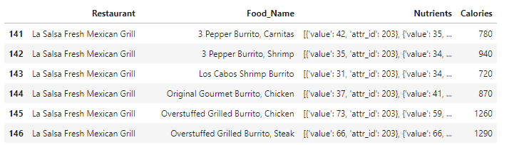

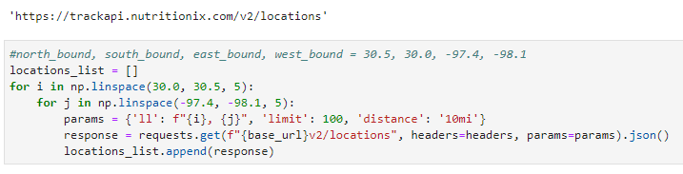
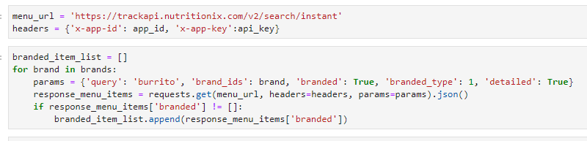
Data Retrieval
Set Boundary
API query for restaurant locations
Filter to unique locations in city
API query for nutrition details
121 locations
Location Query
Nutrition Query
1,433 locations

Slide 4
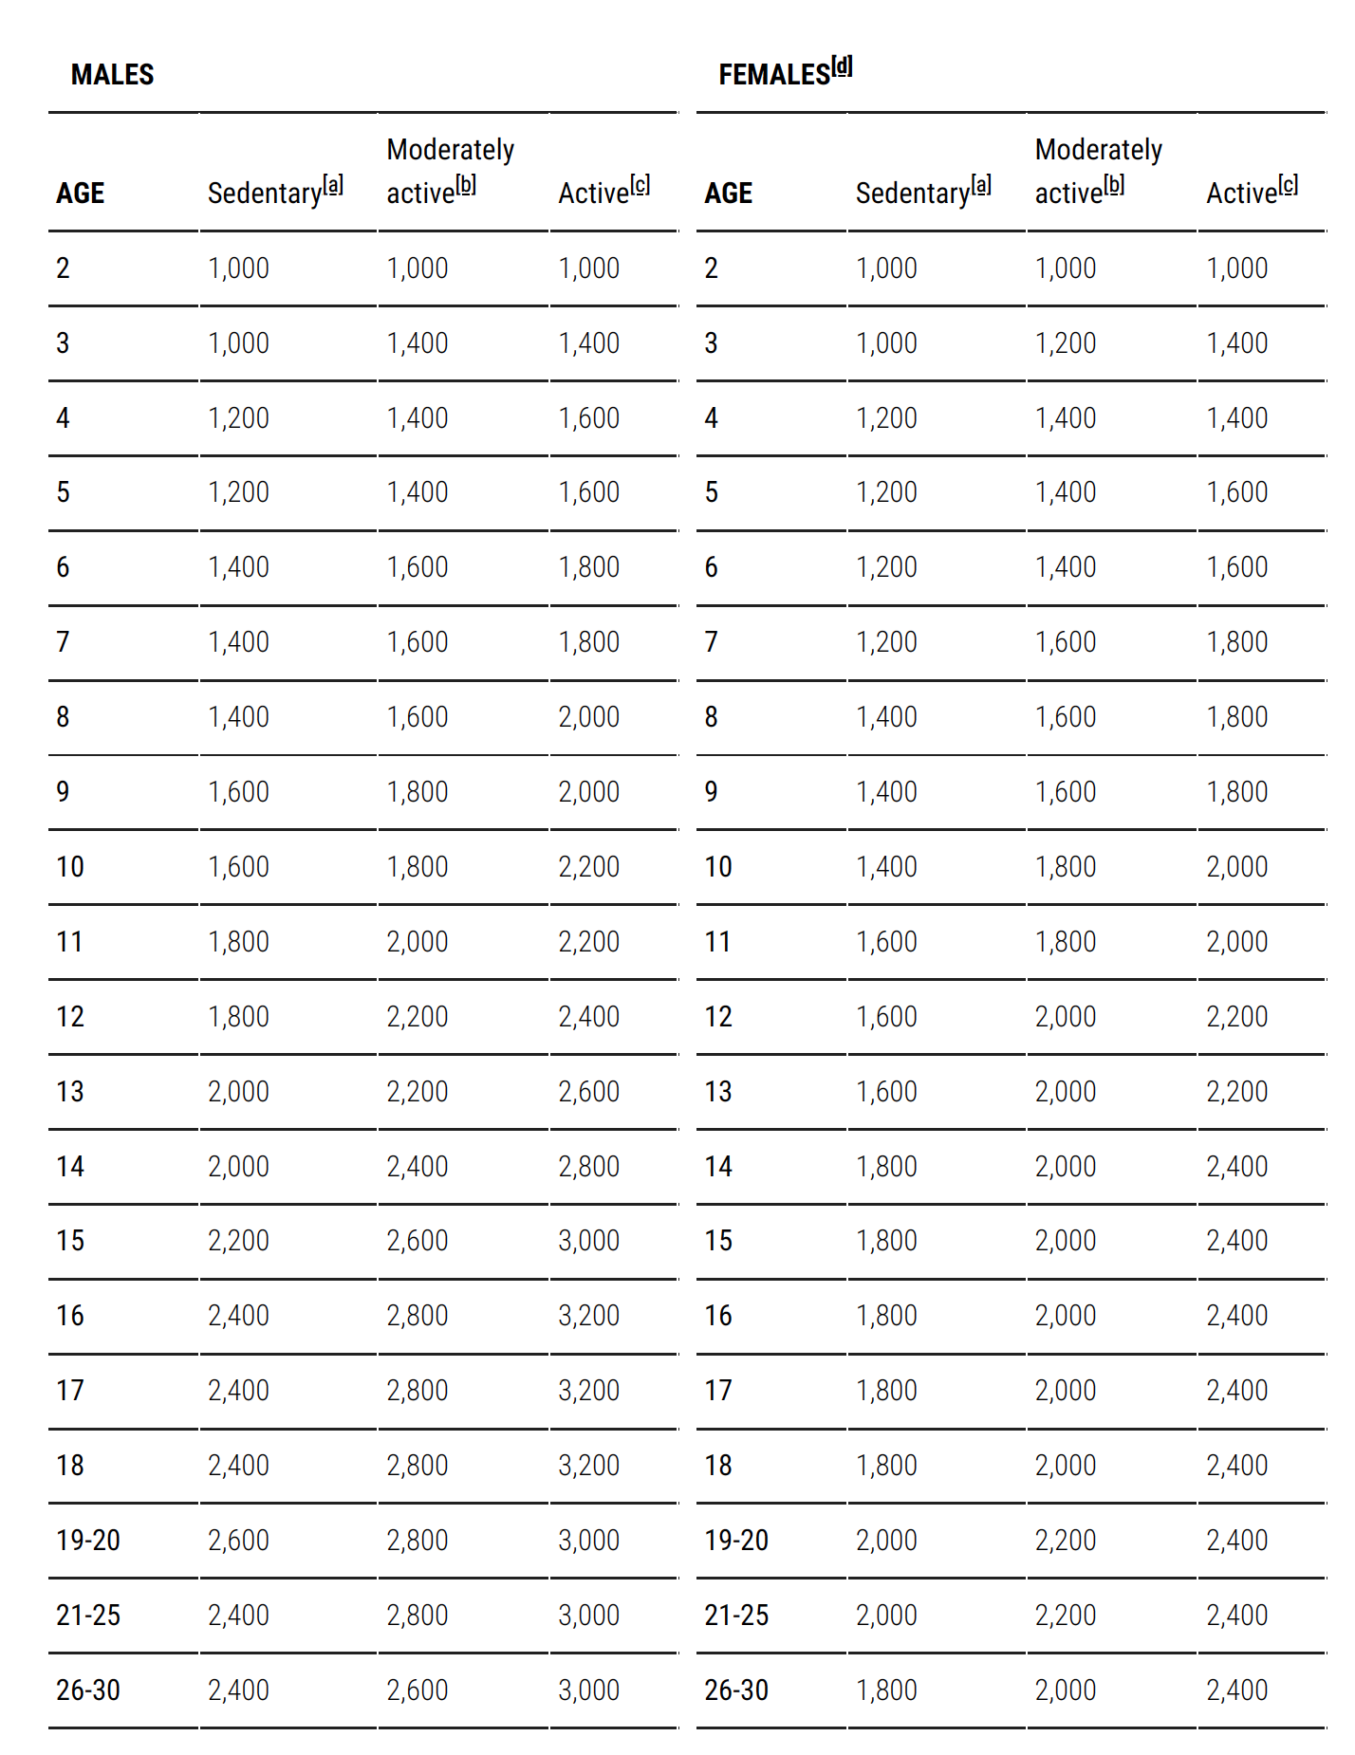
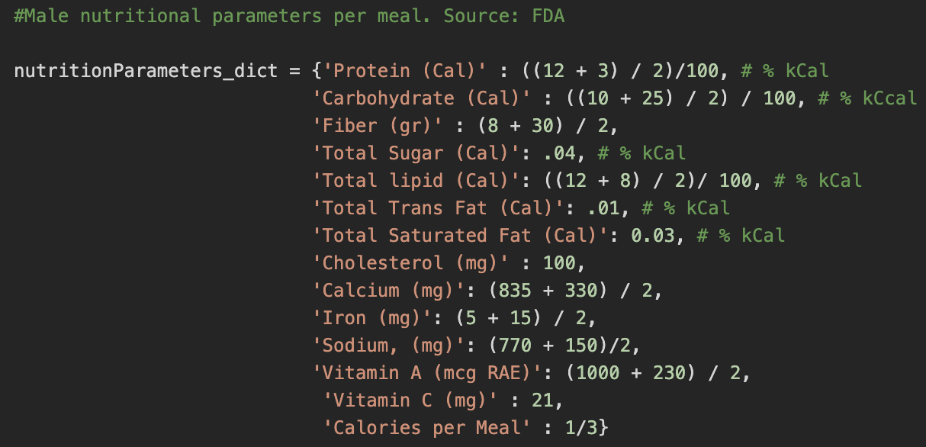
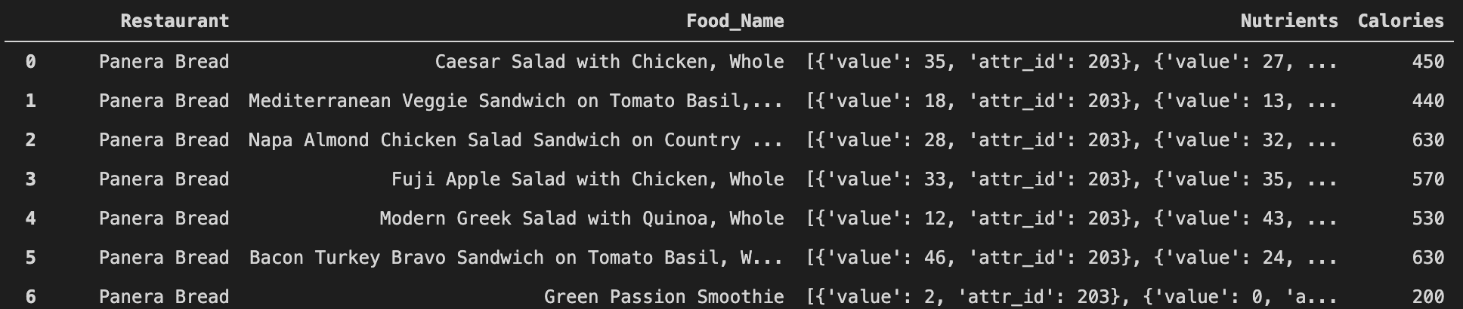
Data Processing
Raw data from the API request …. Ewww…..

Slide 5
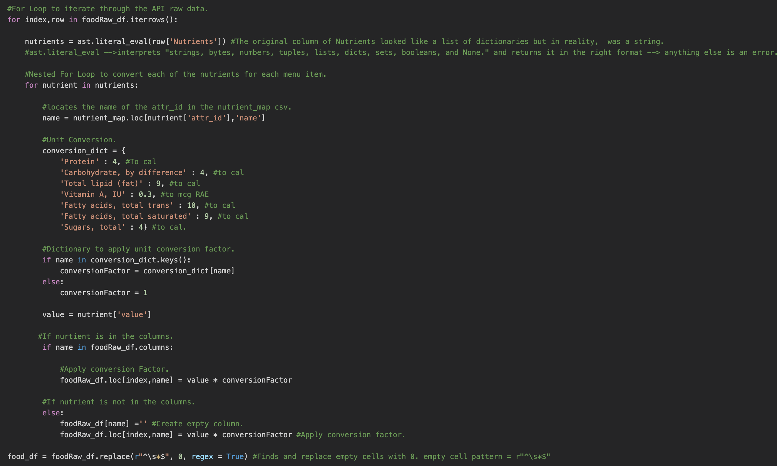
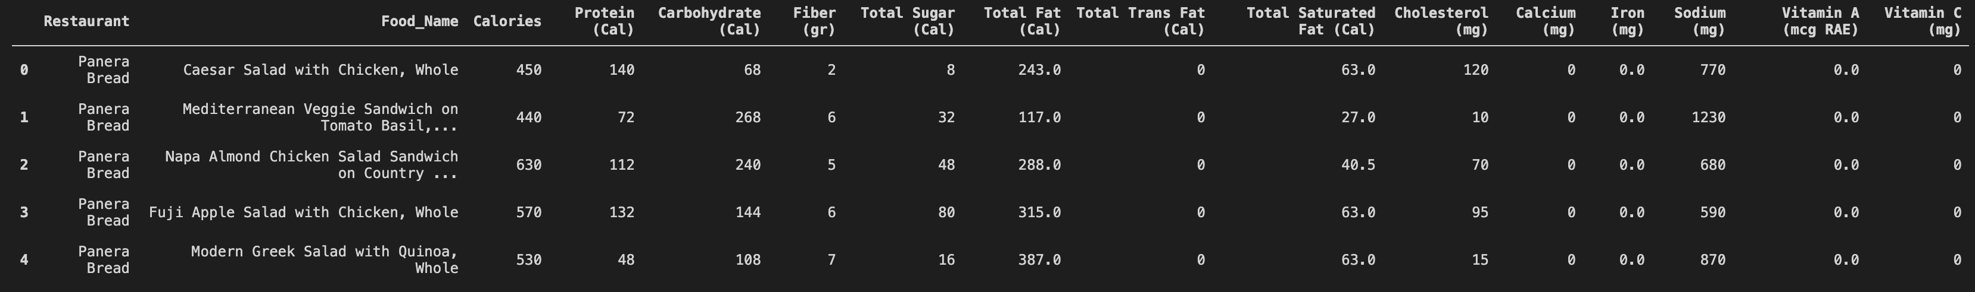
Menu Items Data Manipulation.

Slide 6
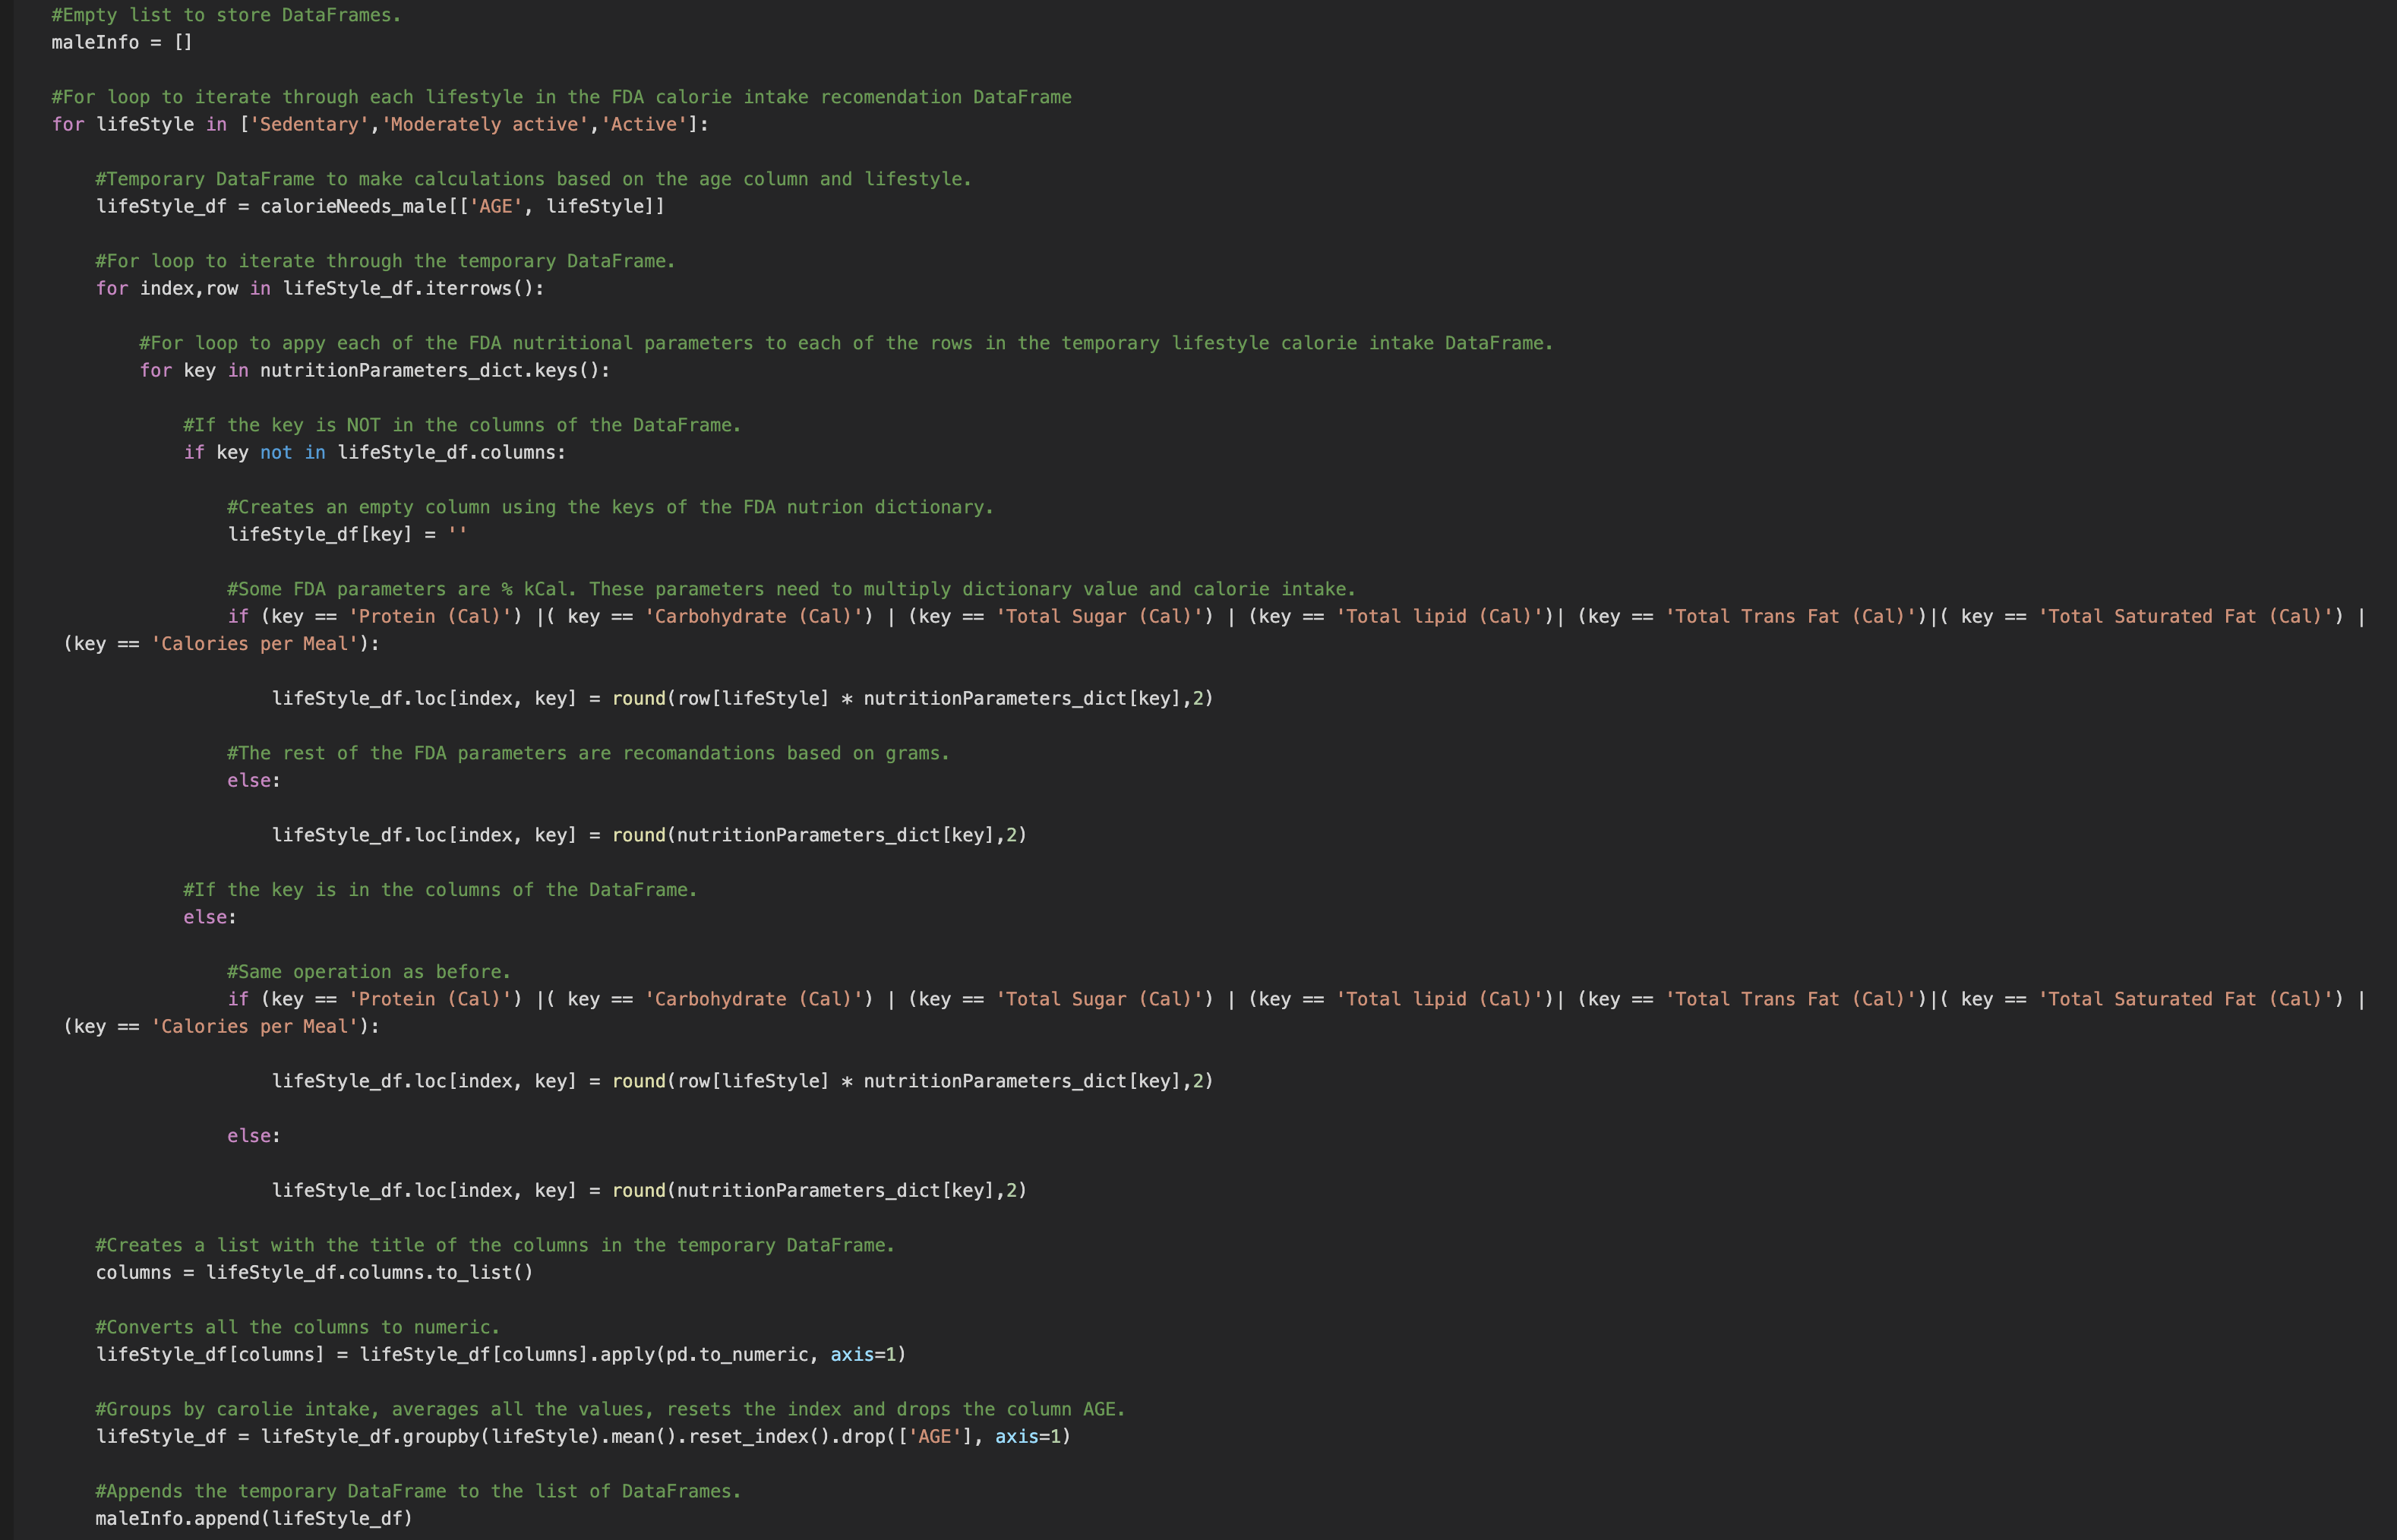
Calorie Intake and Nutritional Requirements.

Slide 7

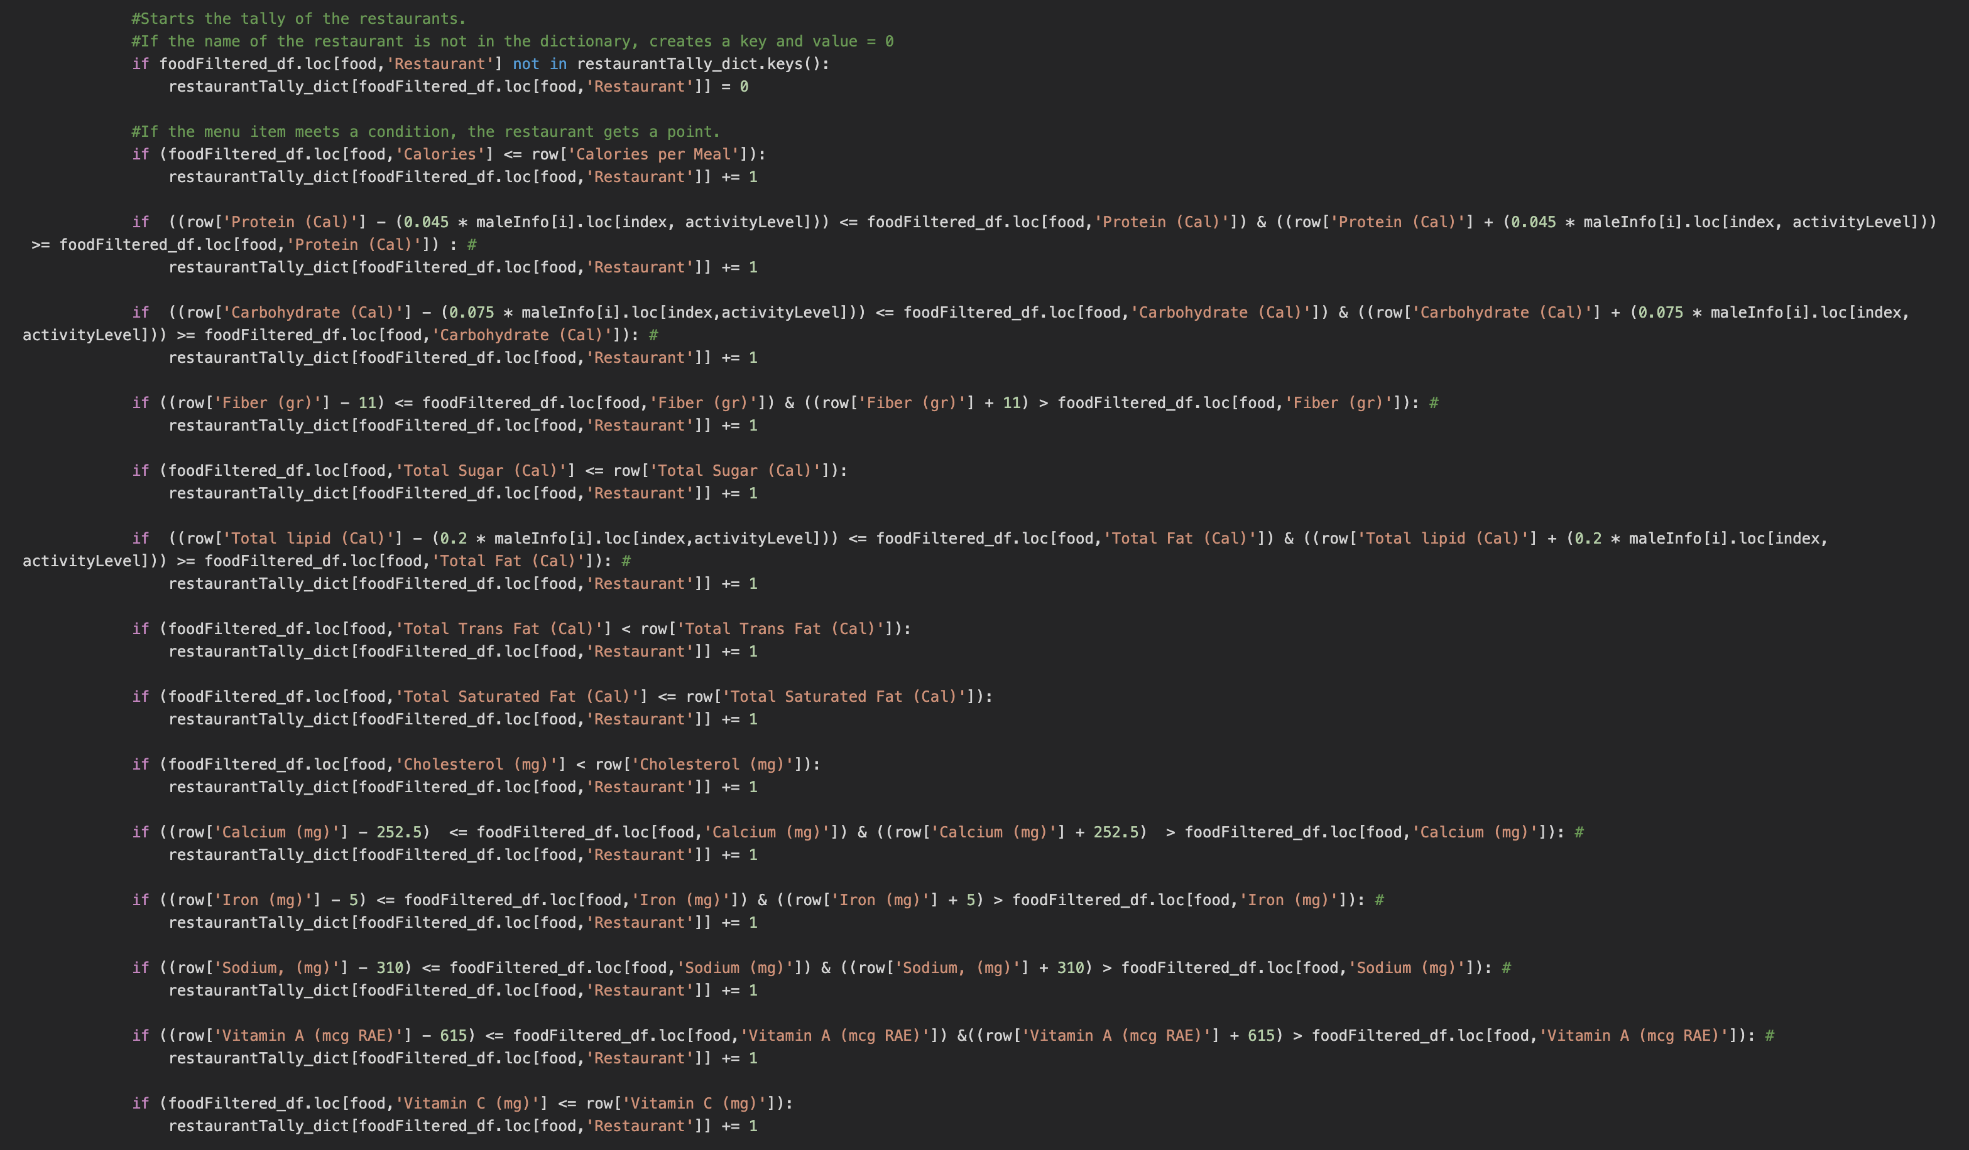
Point System.

Slide 8
Final Output.

Slide 9
Analysis
In this study; the “Healthy Restaurants”, a cross-sectional sample of data was analyzed by comparing the Dietary Nutrients provided per serving by the various Restaurants across Austin-TX.
The Analysis was done across different:
Age Groups,
Gender,
Lifestyle i.e. Active, Moderately Active & Sedentary.

Slide 10
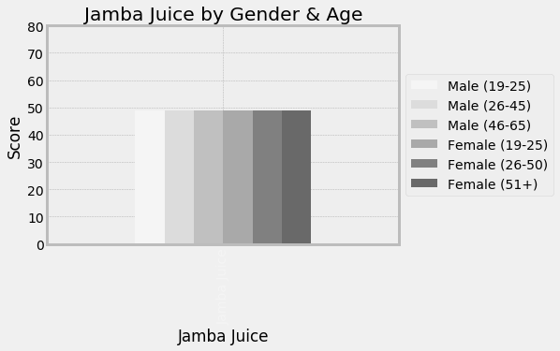
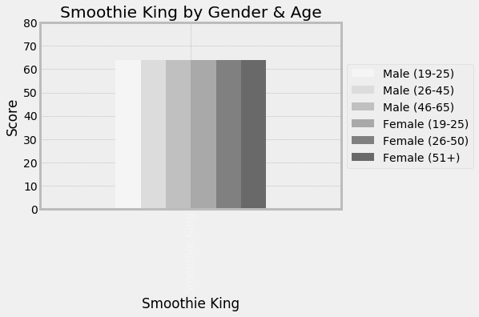
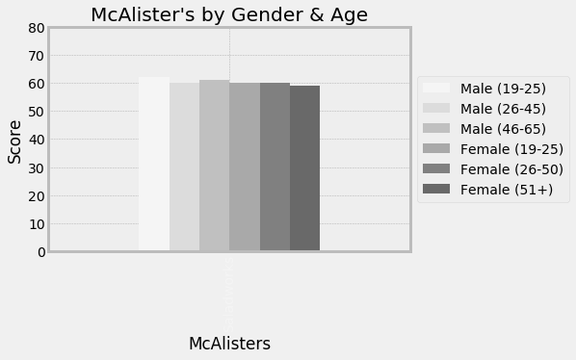
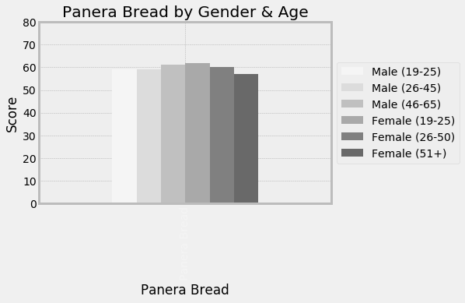
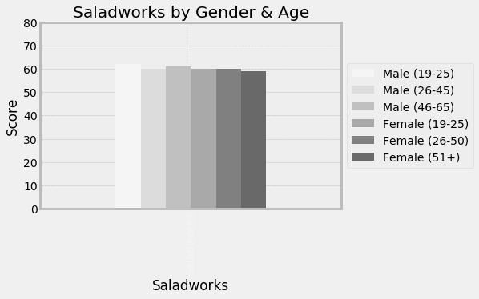
Analysis
Notes:
Based on our analysis, all 5 restaurants met over 50% of the recommended dietary values suggested by the FDA.
Determining if a restaurant is “Healthy” is subjective to many other factors, besides the first 7 menu items.
Meeting 50% of FDA recommended criteria is a good starting point for a healthy restaurant, as other restaurant menu items fall short.
To answer our initial question, ‘Are Healthy Restaurants, Healthy’? We assess that the five restaurants chosen for this project are “healthy”, based on each meeting over 50% of FDA nutrition suggestions.
Jamba Juice had the lowest score due to higher than average carbohydrates and lack of key vitamins.
Our data also shows that men of all ages and younger women benefit the most from “healthy” restaurant menus. But the nutritional advantages are not significant.

Slide 11
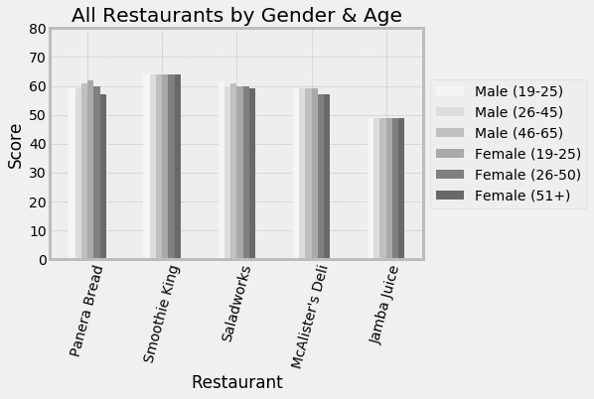
Conclusions
Smoothie King’s menu items had the highest nutrition content values for all genders and ages.
Smoothie King is the healthiest!!
Notes:
Smoothie King had the highest nutrition content values for all genders and ages. But not by much.
Smoothie King’s nutrition values didn’t discriminate by age or gender, meaning it’s just as healthy for you as it is for your 97-year-old grandmother.
Smoothie King is over 10% healthier than the lowest scoring restaurant (Jamba Juice). Scoring a 64 out of 98 possible points.
Smoothie King wins as “The Healthiest”!

